Slide 1
COMP 2230
Week 11 - Wednesday

Slide 2
Last time
Graphing functions
Big-O, Big-Omega, and Big-Theta notation

Slide 3
Questions?

Slide 4
Assignment 5

Slide 5
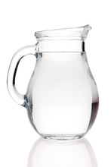
Logical warmup
You have three pitchers whose capacities are three, four, and seven quarts
Only the seven-quart pitcher is full
Pour the fewest times to separate the water into two-, two-, and three-quart quantities

Slide 6
Asymptotic Notations Continued

Slide 7

Orders of functions
If $1 < x$, then
$x < x^{2}$
$x^{2} < x^{3}$
…
So, for $r, s∈ℝ$, where $r < s$ and $x > 1$,
$x^{r} < x^{s}$
By extension, $x^{r} is O(x^{s})$

Slide 8

Proving bounds
Prove a $Θ$ bound for $g(x) = \frac{1}{4}(x – 1)(x + 1)$ for $x∈ℝ$
Prove that $x^{2}$ is not $O(x)$
Hint: Proof by contradiction

Slide 9
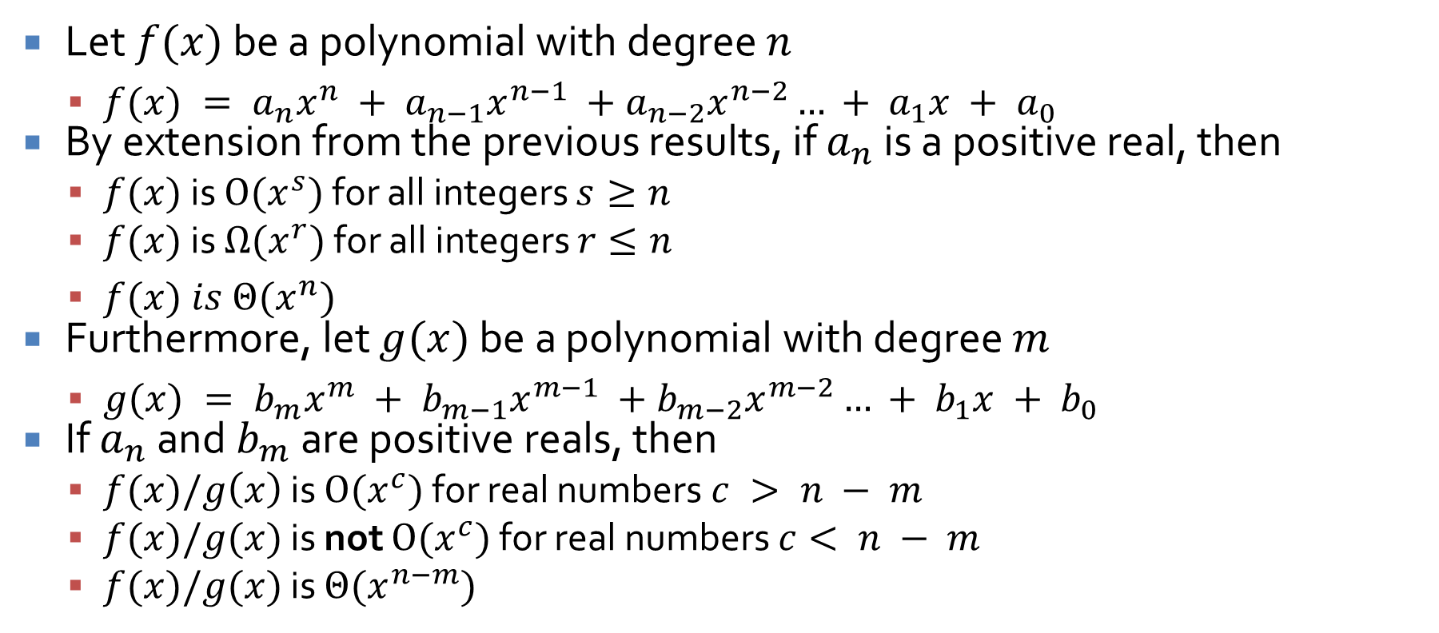
Polynomials
Let $f(x)$ be a polynomial with degree $n$
$f(x) = a_{n}x^{n} + a_{n−1}x^{n−1} +a_{n−2}x^{n−2}… + a_{1}x + a_{0}$
By extension from the previous results, if $a_{n}$ is a positive real, then
$f(x)$ is $O(x^{s})$ for all integers $s≥n$
$f(x)$ is $Ω(x^{r})$ for all integers $r≤n$
$f(x) is Θ(x^{n})$
Furthermore, let $g(x)$ be a polynomial with degree $m$
$g(x) = b_{m}x^{m} + b_{m−1}x^{m−1} +b_{m−2}x^{m−2}… + b_{1}x + b_{0}$
If $a_{n}$ and $b_{m}$ are positive reals, then
$f(x)/g\left(x\right)$ is $O(x^{c})$ for real numbers $c > n − m$
$f(x)/g(x)$ is not $O(x^{c})$ for real numbers $c< n − m$
$f(x)/g(x)$ is $Θ(x^{n−m})$

Slide 10
Algorithm Efficiency and Exponential and Logarithmic Functions
Three-Sentence Summary

Slide 11
Algorithm Efficiency

Slide 12
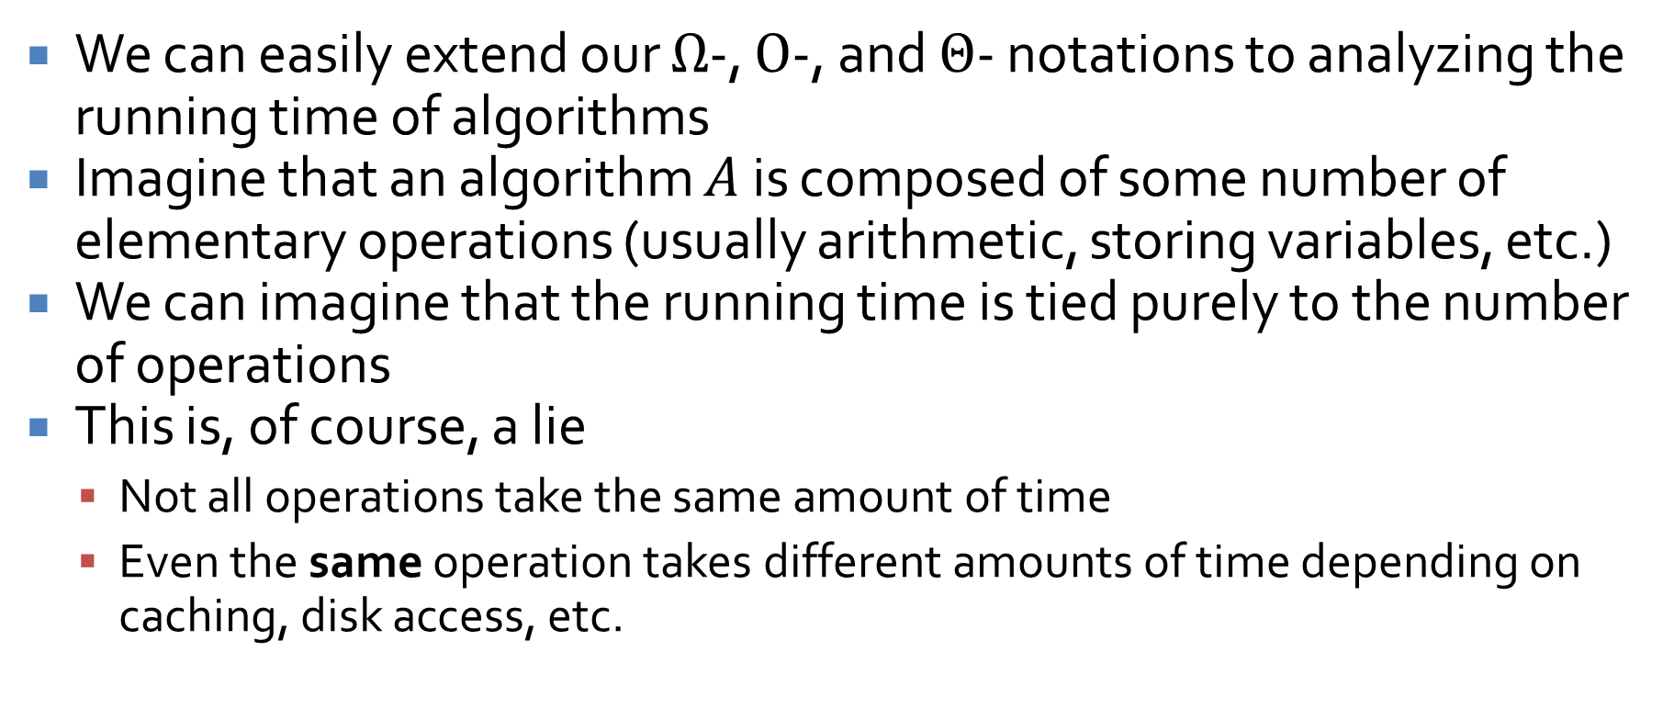
Extending notation to algorithms
We can easily extend our $Ω$-, $O$-, and $Θ$- notations to analyzing the running time of algorithms
Imagine that an algorithm $A$ is composed of some number of elementary operations (usually arithmetic, storing variables, etc.)
We can imagine that the running time is tied purely to the number of operations
This is, of course, a lie
Not all operations take the same amount of time
Even the same operation takes different amounts of time depending on caching, disk access, etc.

Slide 13
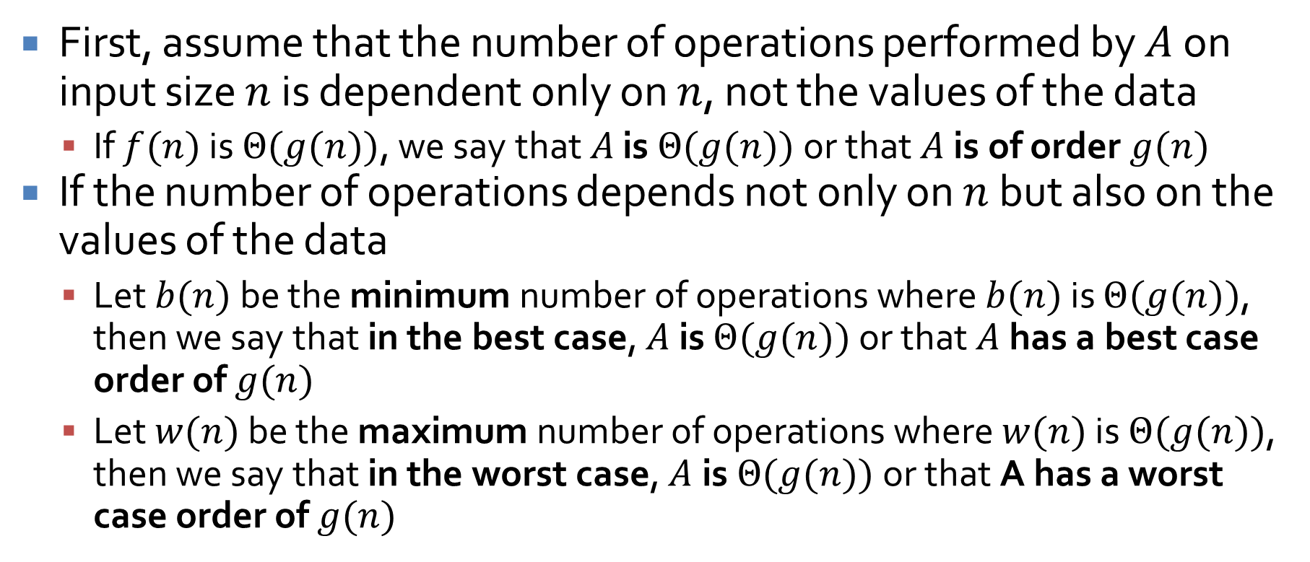
Running time
First, assume that the number of operations performed by $A$ on input size $n$ is dependent only on $n$, not the values of the data
If $f(n)$ is $Θ(g(n))$, we say that $A$ is $Θ(g(n))$ or that $A$ is of order $g(n)$
If the number of operations depends not only on $n$ but also on the values of the data
Let $b(n)$ be the minimum number of operations where $b(n)$ is $Θ(g(n))$, then we say that in the best case, $A$ is $Θ(g(n))$ or that $A$ has a best case order of $g(n)$
Let $w(n)$ be the maximum number of operations where $w(n)$ is $Θ(g(n))$, then we say that in the worst case, $A$is $Θ(g(n))$ or that A has a worst case order of $g(n)$

Slide 14
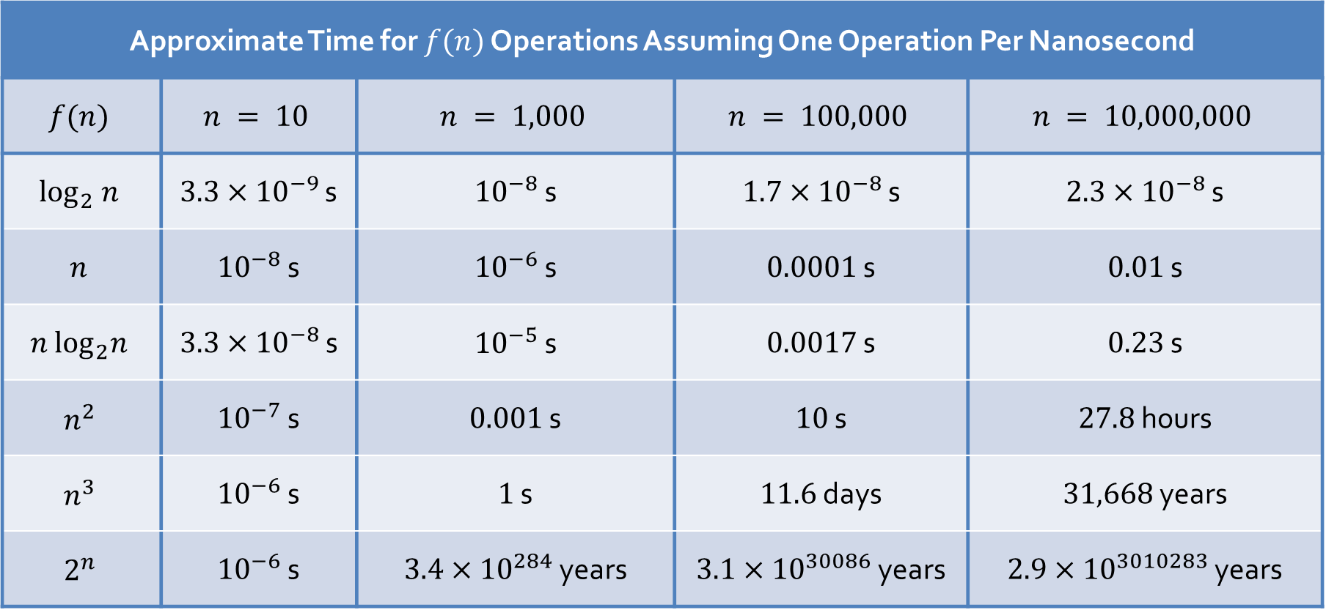
Time
Approximate Time for $f(n)$ Operations Assuming One Operation Per Nanosecond
$$f(n)$$ | $$n = 10$$ | $$n = 1,000$$ | $$n = 100,000$$ | $$n = 10,000,000$$
$$\log_{2} n$$ | $3.3×{10}^{−9}$ s | ${10}^{−8}$ s | $1.7×{10}^{−8}$ s | $2.3×{10}^{−8}$ s
$$n$$ | ${10}^{−8}$ s | ${10}^{−6}$ s | $0.0001$ s | $0.01$ s
$$n \log_{2}n$$ | $3.3×{10}^{−8}$ s | ${10}^{−5}$ s | $0.0017$ s | $0.23$ s
$$n^{2}$$ | ${10}^{−7}$ s | $0.001$ s | $10$ s | $27.8$ hours
$$n^{3}$$ | ${10}^{−6}$ s | $1$ s | $11.6$ days | $31,668$ years
$$2^{n}$$ | ${10}^{−6}$ s | $3.4×{10}^{284}$ years | $3.1×{10}^{30086}$ years | $2.9×{10}^{3010283}$ years

Slide 15
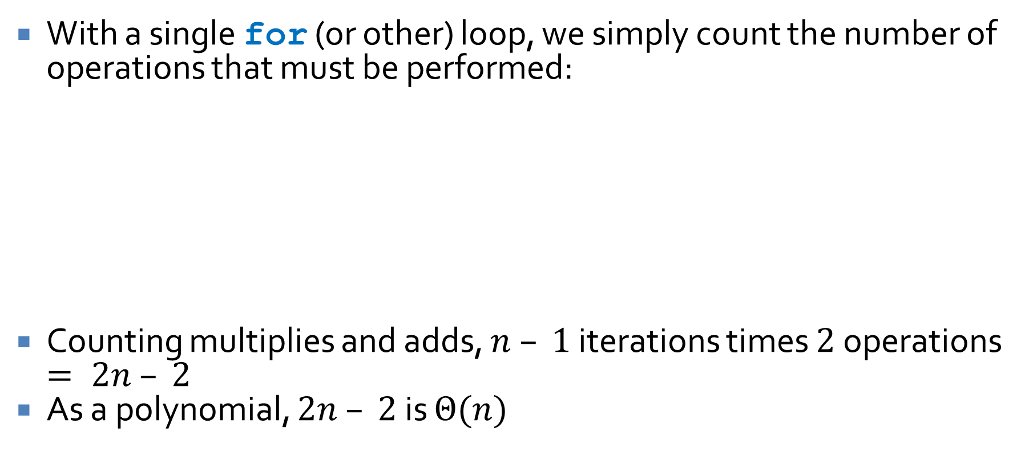
Computing running time
With a single for (or other) loop, we simply count the number of operations that must be performed:
Counting multiplies and adds, $n – 1$ iterations times $2$ operations $= 2n – 2$
As a polynomial, $2n – 2$ is $Θ(n)$
int p = 0;
int x = 2;
for (int i = 2; i <= n; ++i) {
p = (p + i)*x;
}

Slide 16

Nested loops
When loops do not depend on each other, we can simply multiply their iterations (and asymptotic bounds)
Clearly $(n – 1)(n −2)$ is $Θ(n^{2})$
int p = 0;
for (int i = 2; i <= n; ++i) {
for (int j = 3; j <= n; ++j) {
++p;
}
}

Slide 17
Trickier nested loops
When loops depend on each other, we have to do more analysis
What's the running time here?
Arithmetic sequence saves the day (for the millionth time)
int s = 0;
for (int i = 1; i <= n; ++i) {
for (int j = 1; j <= i; ++j) {
s = s + j*(i – j + 1);
}
}

Slide 18
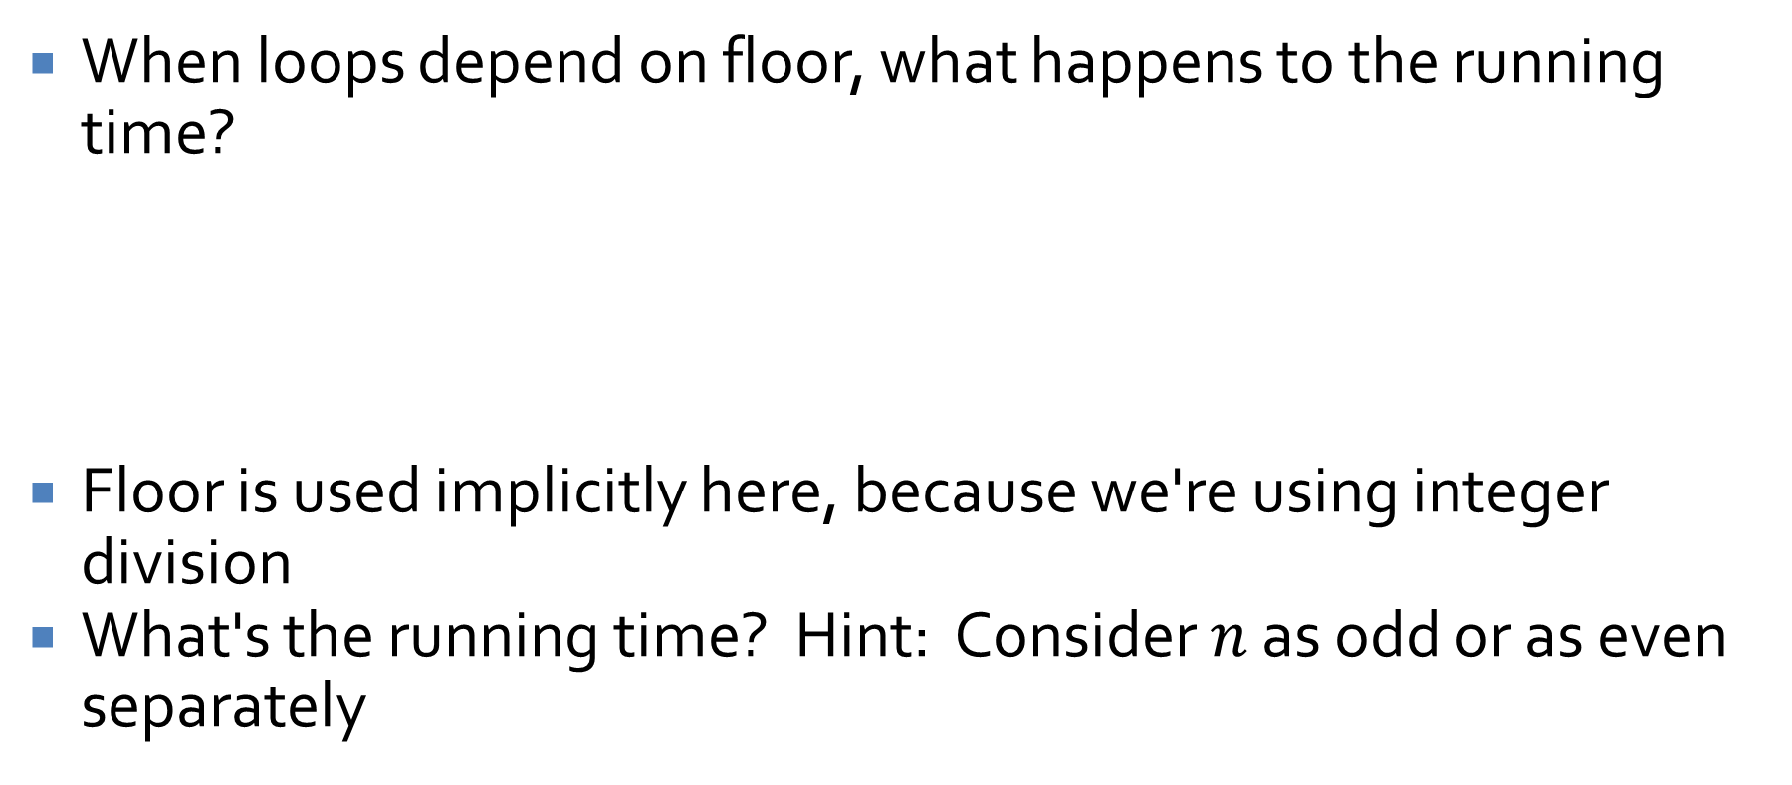
Iterations with floor
When loops depend on floor, what happens to the running time?
Floor is used implicitly here, because we're using integer division
What's the running time? Hint: Consider $n$ as odd or as even separately
int a = 0;
for (int i = n/2; i <= n; ++i) {
a = n - i;
}

Slide 19
Sequential search
Consider a basic sequential search algorithm:
What's its best case running time?
What's its worst case running time?
What's its average case running time?
int search(int[] array, int n, int value) {
for (int i = 0; i < n; ++i) {
if (array[i] == value) {
return i;
}
}
return -1;
}

Slide 20
Insertion sort algorithm
Insertion sort is a common introductory sort
It's suboptimal, but it's one of the fastest ways to sort a small list (10 elements or fewer)
The idea is to sort initial segments of an array, insert new elements in the right place as they are found
So, for each new item, keep moving it up until the element above it is too small (or we hit the top)

Slide 21
Insertion sort in code
public static void sort( int[] array, int n) {
for (int i = 1; i < n; ++i) {
int next = array[i];
int j = i - 1;
while (j != 0 && array[j] > next) {
array[j+1] = array[j];
--j;
}
array[j] = next;
}
}

Slide 22
Best case analysis of insertion sort
What is the best case analysis of insertion sort?
Hint: Imagine the array is already sorted

Slide 23
Worst case analysis of insertion sort
What is the worst case analysis of insertion sort?
Hint: Imagine the array is sorted in reverse order

Slide 24
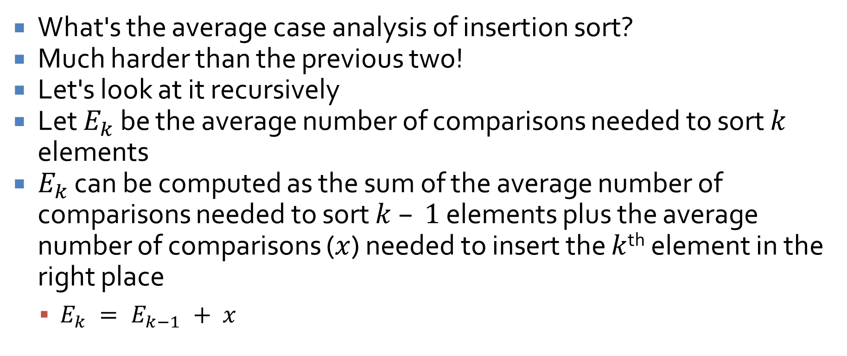
Average case analysis of insertion sort
What's the average case analysis of insertion sort?
Much harder than the previous two!
Let's look at it recursively
Let $E_{k}$ be the average number of comparisons needed to sort $k$ elements
$E_{k}$ can be computed as the sum of the average number of comparisons needed to sort $k – 1$ elements plus the average number of comparisons ($x$) needed to insert the $k$^{th} element in the right place
$E_{k} = E_{k−1} + x$

Slide 25
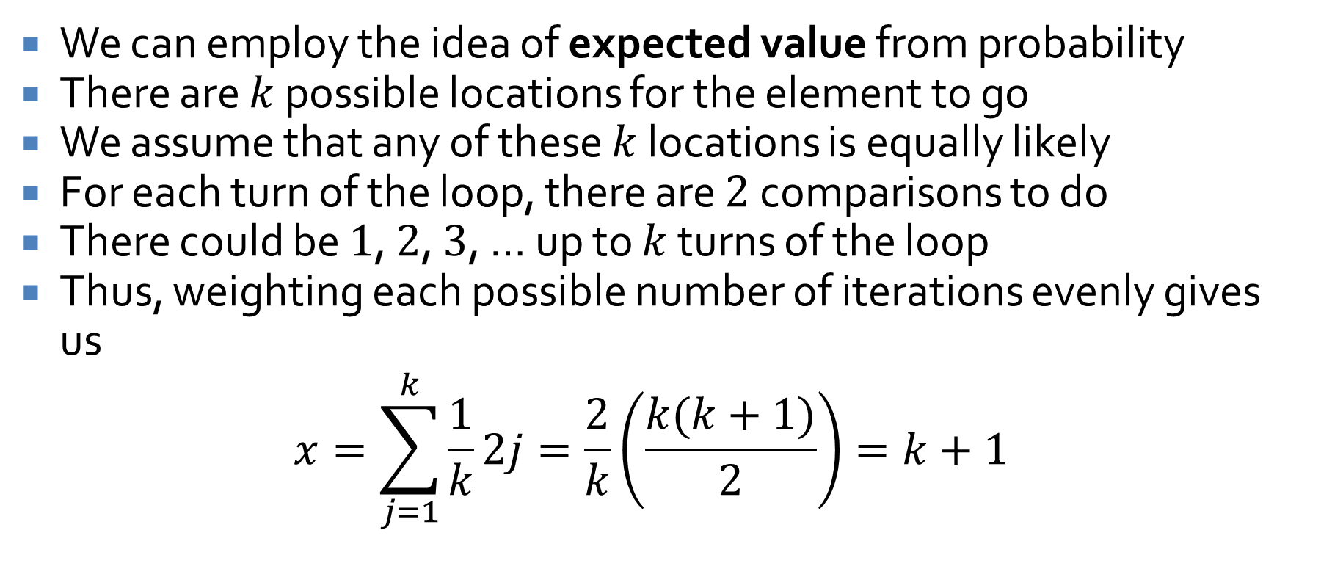
Finding x
We can employ the idea of expected value from probability
There are $k$ possible locations for the element to go
We assume that any of these $k$ locations is equally likely
For each turn of the loop, there are $2$ comparisons to do
There could be $1$, $2$, $3$, … up to $k$ turns of the loop
Thus, weighting each possible number of iterations evenly gives us
$$x=\sum_{j=1}^{k}{\frac{1}{k}2j=\frac{2}{k}\left(\frac{k(k+1)}{2}\right)}=k+1$$

Slide 26
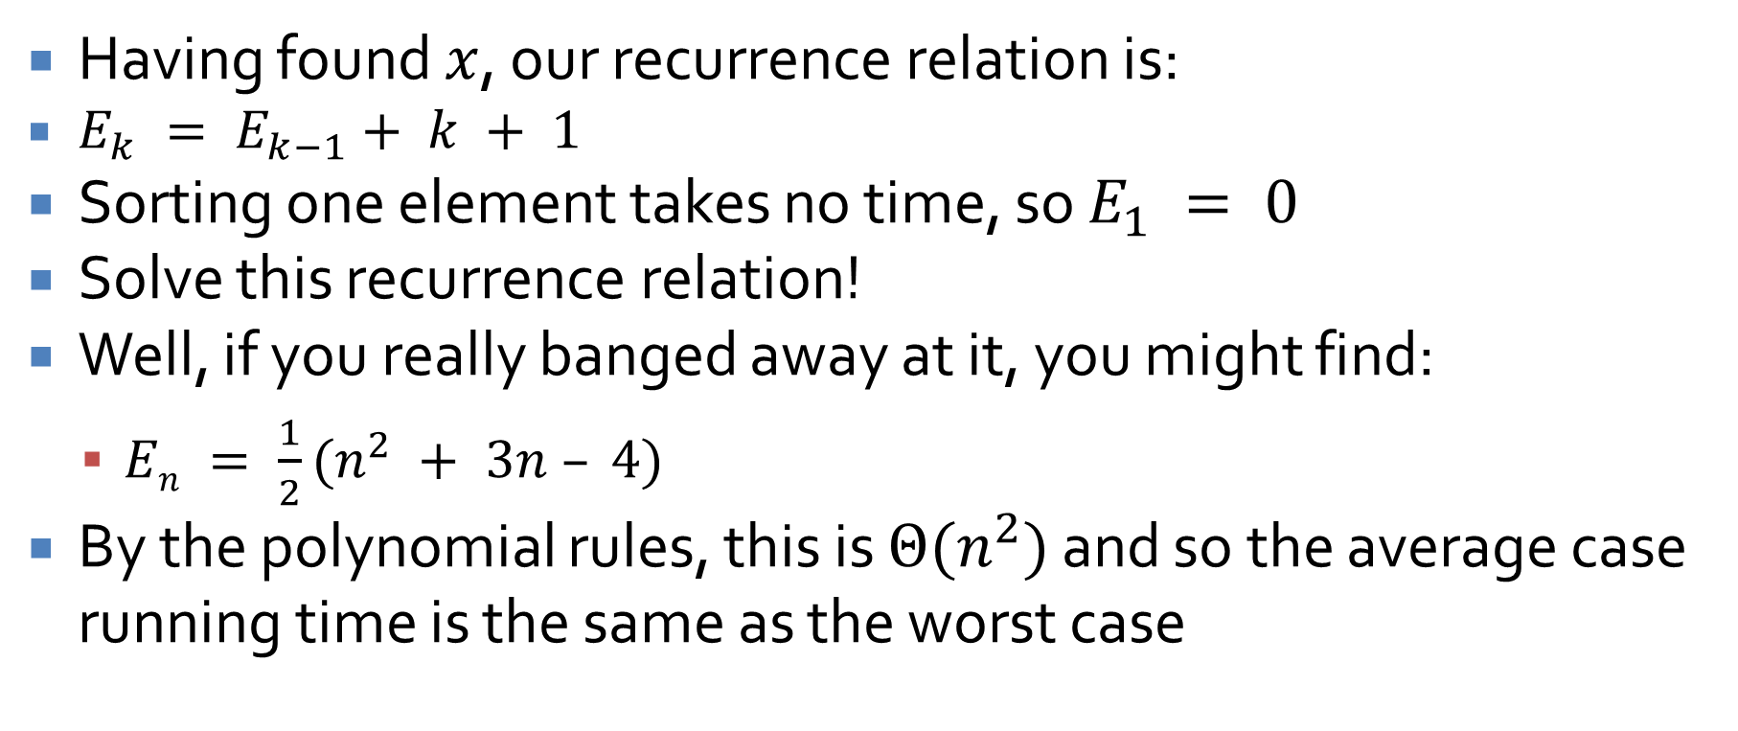
Finishing the analysis
Having found $x$, our recurrence relation is:
$E_{k} = E_{k−1}+ k + 1$
Sorting one element takes no time, so $E_{1} = 0$
Solve this recurrence relation!
Well, if you really banged away at it, you might find:
$En = \frac{1}{2}(n^{2} + 3n – 4)$
By the polynomial rules, this is $Θ(n^{2})$ and so the average case running time is the same as the worst case

Slide 27
Upcoming

Slide 28
Next time…
Exponential and logarithmic functions
Review for Exam 3

Slide 29
Reminders
Finish Assignment 5
Study for Exam 3 on Monday

